Slide 1

Sprocket Central Pty Ltd
Data Analytics Approach

Slide 2
Agenda
Introduction
Data Exploration
Model Development
Interpretation

Slide 3

Introduction
By analysing customer insights, Sprocket Central could optimise resource allocation and improve marketing performance
By analyzing the old datasets, high-value customers can be identified or modeled
Applying the model to the new dataset can help identify potential high-value customers
The marketing team at Sprocket Central can then utilize the results to tailor marketing strategies and drive business growth

Slide 4
Data Exploration
Data Quality Assessment and Data Cleaning
Key Issues for Data Quality Assessment:
Inaccurate data and data type
Inconsistent data values for the same attribute
Columns have empty values in certain records
Data Relevancy
An in-depth analysis has been sent via email

Slide 5
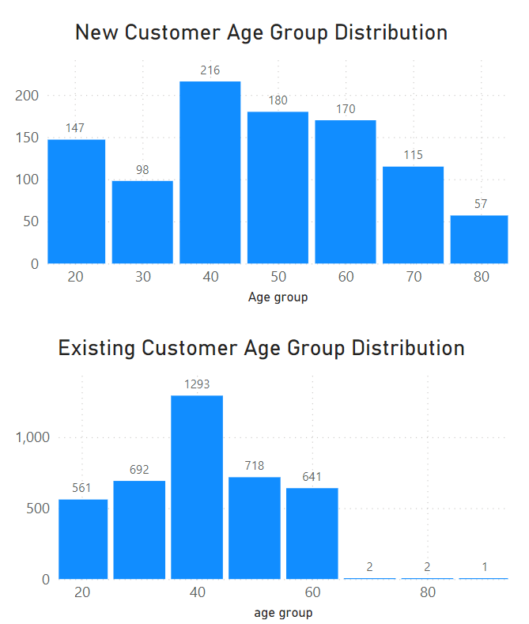
Data Exploration
Age Distributions for New and Existing Customer
Customers age ranges from 20 - 80
Most customers are aged between 40 - 49 for both new and existing customers
There is a steep drop of customers in 30-39 age group in new customers

Slide 6
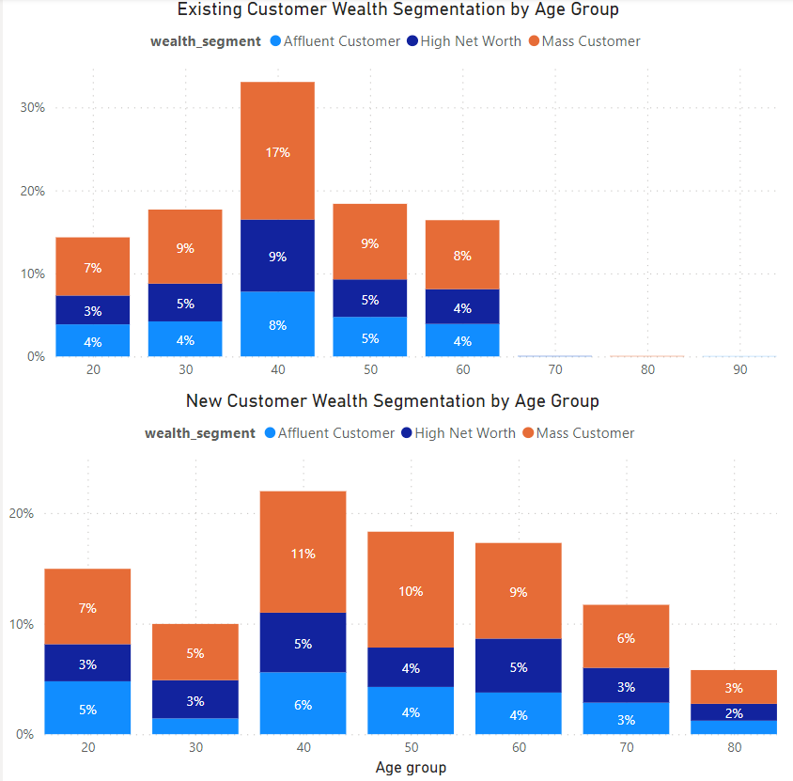
Data Exploration
Customer Wealth Segmentation by Age Group
Among all age groups, the largest number of customers are ‘Mass Customer’
The ‘Affluent Customer’ can outperforms the ‘High Net Worth’ customer in the 20-29 and 40-49 age groups

Slide 7
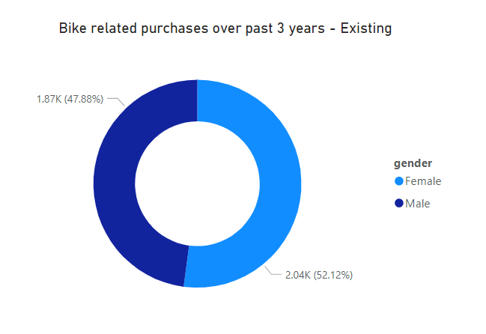
Data Exploration
Bike related purchases over last 3 years by gender
Upon analysing existing customer’s past shopping behaviour, it is observed that Female customers make slightly more bike related purchases than male

Slide 8
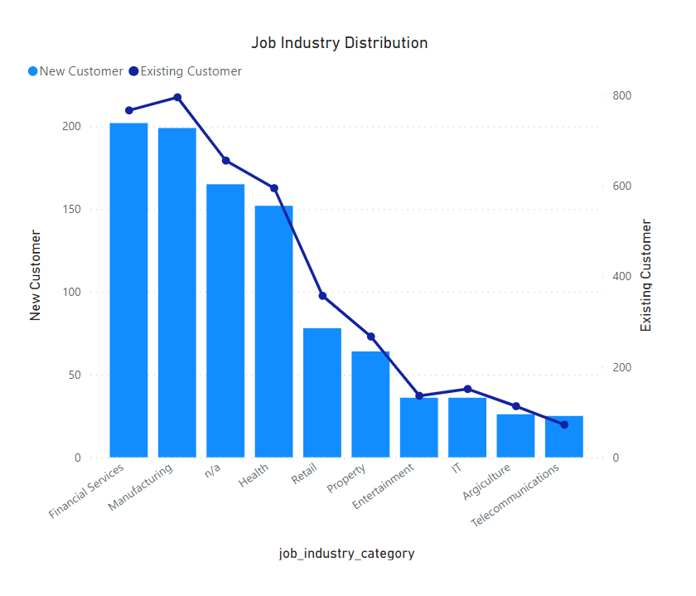
Data Exploration
Job Industry Distribution
Both New and Existing Customers have the similar job industry distriution
More Financial Services industry than Manufacturing for the new customer datasets
The smallest number of customers are in Agriculture and Telecommunications

Slide 9
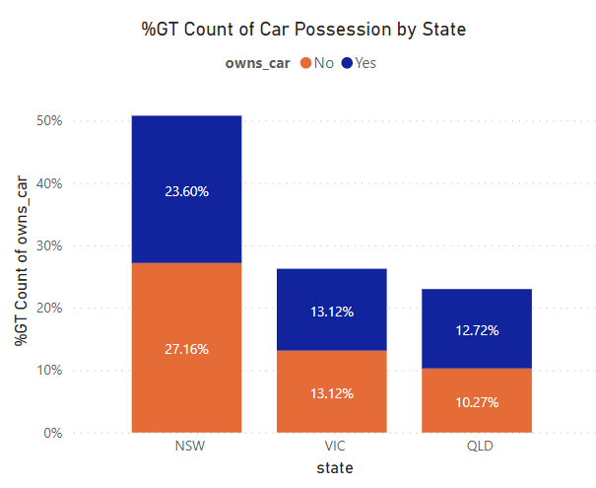
Data Exploration
Car Possession Distribution in Different States (New Customers)
The majority of new customers, like the existing customers, are from NSW.
Fewer car owners in NSW.
There are more people who own a car in QLD.

Slide 10
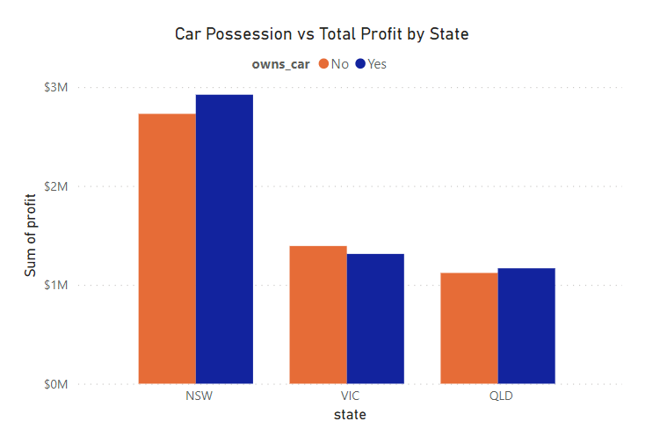
Data Exploration
Car Possession vs Total Profit by State (Existing Customers)
By analyzing the transaction history of existing customers, it was found that car owners in NSW and QLD are more likely to purchase high-profit products.

Slide 11
Data Modeling (RFM Segmentation)
RFM Segmentation enables marketers to define high-value customers based on their Recency, Frequency and Monetary.
RFM analysis is used to determine which customers a business should target in order to increase revenue and value.
By assigning scores ranging from 1 to 5 to each discipline, the customer types can be segmented based on the combination of RFM scores.

Slide 12
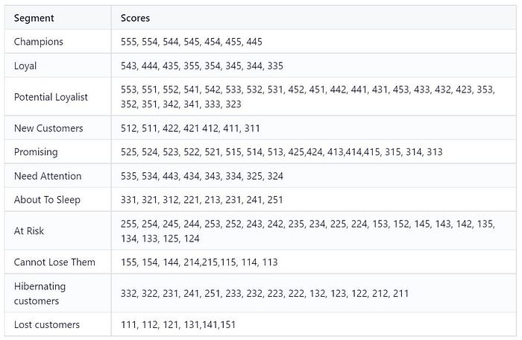
Data Modeling (RFM Segmentation)
Score Segment Table

Slide 13
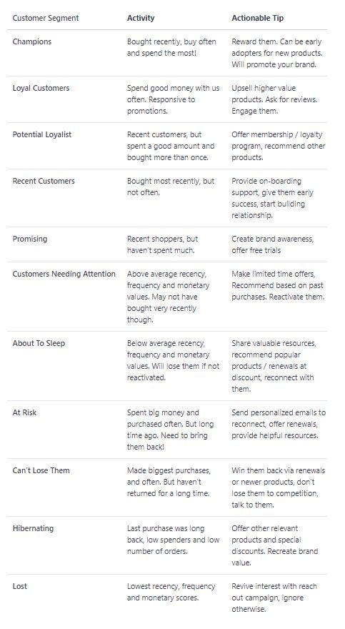
Interpretation
Customer Segmentation Explaination and Action Tip
Place any information about this point here.

Slide 14
Appendix

Slide 15
Appendix
References
Ploii Tubsamon. (2021, September 3). RFM Analysis for Customer Segmentation with Power BI. Medium. https://ploiitubsamon.medium.com/rfm-analysis-for-customer-segmentation-with-power-bi-5d2f5bd62038
Work Repository
https://github.com/stephy416/KPMG_virtual_internship

Slide 16
Thank you

